Slide 1
FTP
An application layer protocol
  It uses TCP at Transport layer.
State-full protocol.
  The server requires to retain session information or status about each communicating partner for the duration of multiple requests.
Out-of-band Control
  passes control data on a separate connection from main data

Slide 2
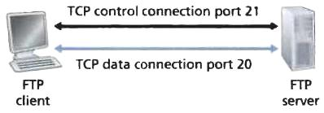
FTP
It opens two ports-
  Port no. 21, control information is transferred over this
  Port no. 20, data is transferred over this.

Slide 3
Active/ Passive Modes
FTP may run in active or passive mode, which determines how the data connection is established
In both cases, the client creates a TCP control connection from a random port N to the FTP server command port 21
In active mode, the client starts listening for incoming data connections from the server on port M
  It sends the FTP command PORT M to inform the server on which port it is listening.
  The server then initiates a data channel to the client from its port 20, the FTP server data port.

Slide 4
Active/ Passive Modes
In situations where the client is behind a firewall and unable to accept incoming TCP connections, passive mode may be used.
  Here the client uses the control connection to send a PASV command to the server and then receives a server’s socket number from the server, which the client then uses to open a data connection from an arbitrary client port to the server socket number received
The server responds over the control connection with three-digit status codes in ASCII with an optional text message.
  For example, "200" (or "200 OK") means that the last command was successful.

Slide 5
Steps to transfer file over FTP
User provides hostname, causing the FTP client process requests a TCP connection (21)
User provides username and password
After user authentication, user copies files from server.
FTP keeps control connection open for a user session, whereas a TCP connection is established for each file requested by user.

Slide 6
FTP Commands
FTP login utilizes a normal username and password scheme for granting access.
The username is sent to the server using the USER command, and the password is sent using the PASS command.
List: Returns information of a file or directory if specified
Retr: Retrieve a copy of the file
Stor: Accept the data and to store the data as a file at the server site

Slide 7
FTP Replies
Each command is followed by a reply.
Replies are 3 digit number.
  331-username ok, password required
  425 – data connection can’t be opened.
  452 – Insufficient storage space in system. File unavailable (e.g., file busy)

Slide 8
SMTP

Slide 9
What is SMTP?
The de facto standard for e-mail transmissions across the Internet
It is defined in RFC 821
A relatively simple, text-based protocol
Not entirely secure, vulnerable to SPAM

Slide 10
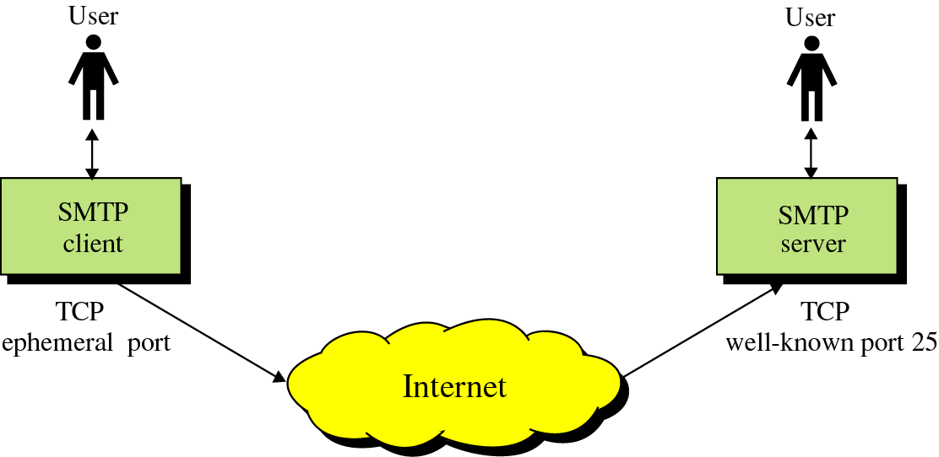
SMTP
Goal: To transfer mail reliably and efficiently

Slide 11
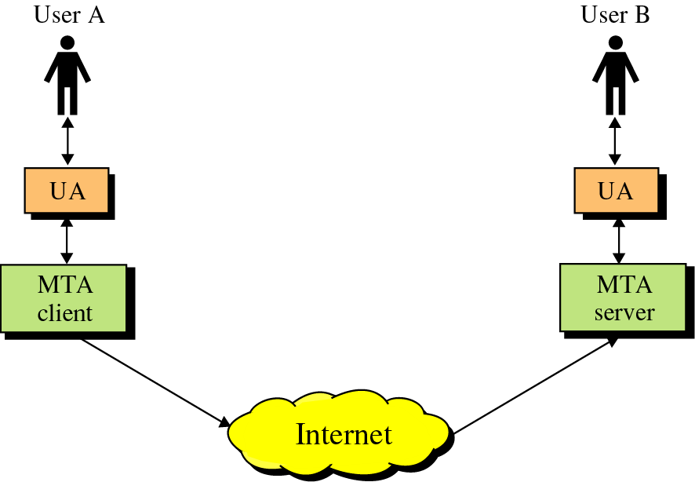
SMTP
SMTP clients and servers have two main components:
  (UA): Prepares the message, encloses it in an envelope.
  (MTA): Transfers the mail across the internet
User Agent
Mail Transfer Agents

Slide 12
Our Postal Mail
Every mail package is wrapped within an envelope that contains:
  Sender's name and address.
  Recipient's name and address.
  Post office's stamp.
  A timestamp when package was received.
There is no guarantee that the sender's name and address will always be correct. It is very easy to forge the sender's identity.
If the sender and receiver are in the same town, your local post office will not send the package to any other post office.
Although the sender's identity cannot be trusted, you can still find a few things about the package by looking at the envelope such as the town letter was mailed from and time.
Every post office is assigned a postal code or Pin code, which is used to identify it location. It is possible that in one post office may handle multiple Pin codes.

Slide 13
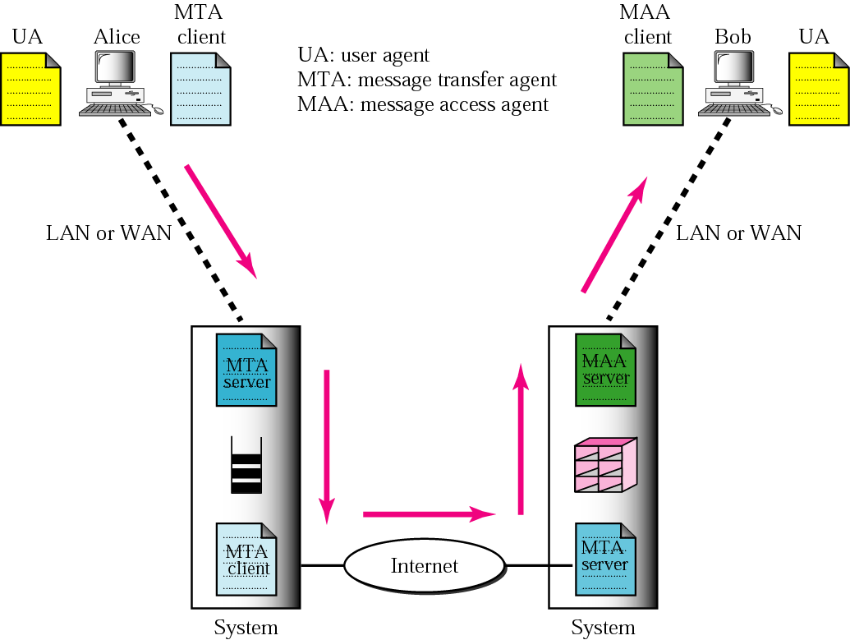
SMTP
Transfers mails from one host to another
Collects mail and delivers to user agent
Transfers mails from one host to another
Collects mail and delivers to user agent
Composes, reads,
replies to
,forwards and handles mailboxes

Slide 14
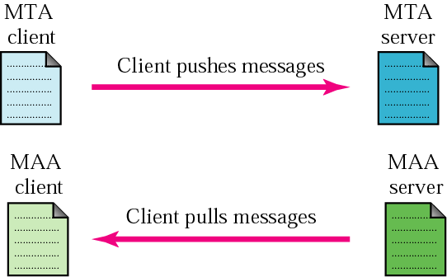
Message Transfer…
SMTP is a push protocol

Slide 15
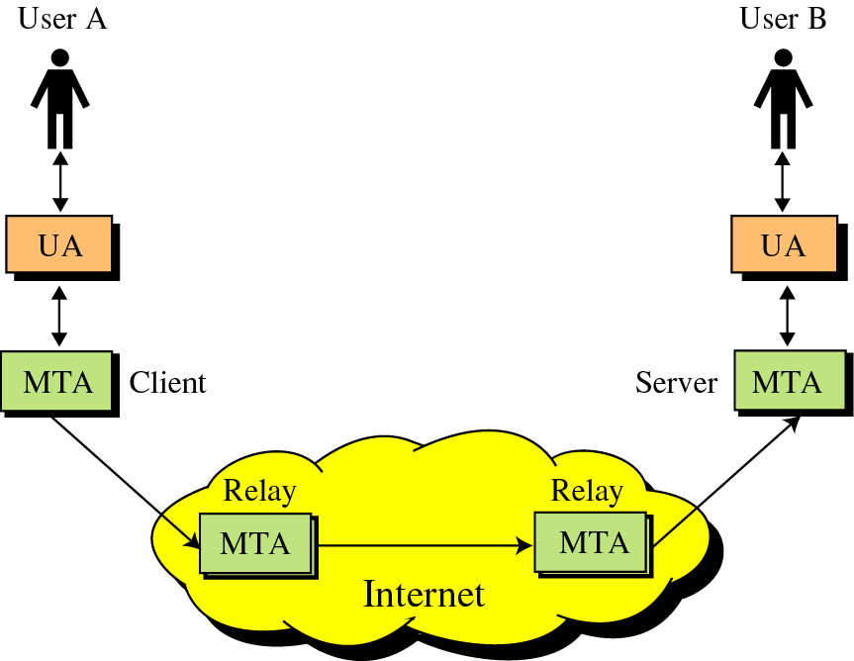
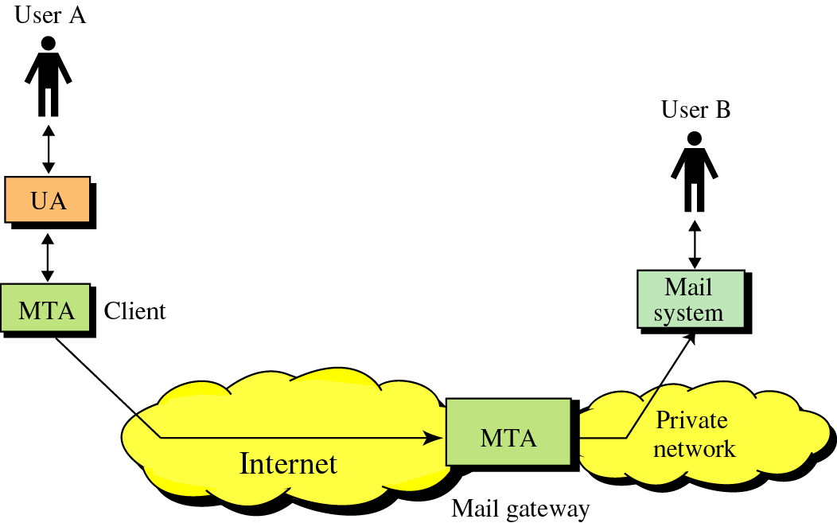
Relays and Gateways
SMTP server can also assume the role of a “relay”
SMTP mail gateways are used to transport mail prepared by a protocol other than SMTP
Non-SMTP supported
SMTP supported

Slide 16
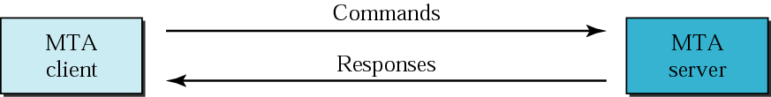
How SMTP works?
Command format:
Keyword: argument(s)
Response format:
3-digit status code [textual information]
Link Layer PCI
Link Layer PCI
IP-PCI
IP-PCI
TCP-PCI
TCP-PCI
TCP-PCI
SMTP command/response
SMTP command/response
SMTP command/response

Slide 17
SMTP A-PDU’s
The Basics
Keyword | Arguments
HELO | Sender’s host domain name
MAIL FROM: | Email address of sender
RCPT TO: | Email of intended recipient
DATA | Body of the message
QUIT

Slide 18
How SMTP works: Status Codes
The Server responds with a 3 digit code that may be followed by text info
  2## - Success
  3## - Command can be accepted with more information
  4## - Command was rejected, but error condition is temporary
  5## - Command rejected, Bad User!

Slide 19
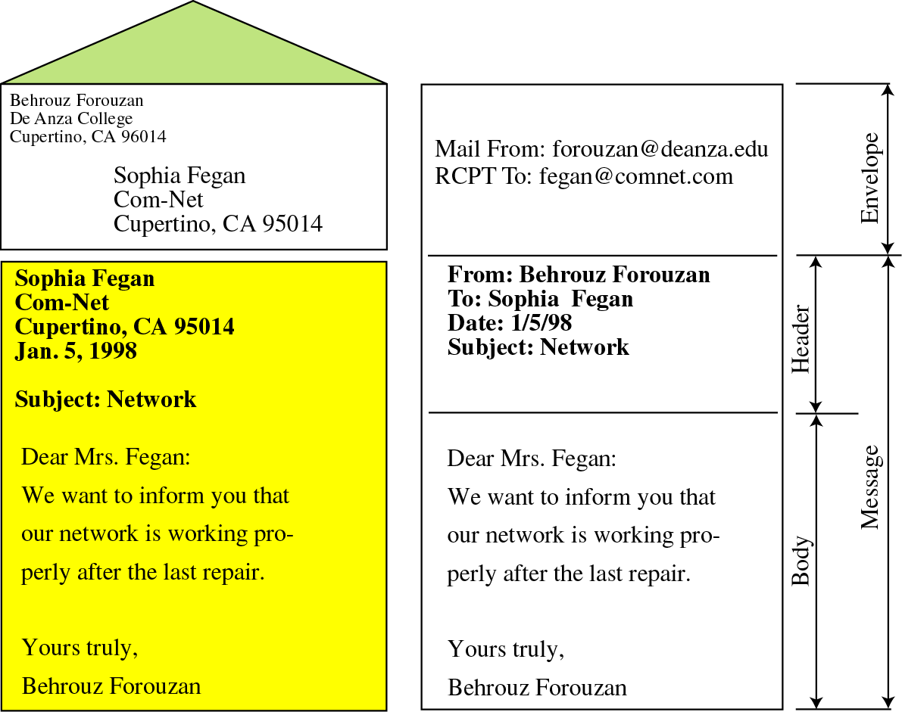
Traditional mail Vs Email
E-mail envelope and body
Traditional mail envelope and body

Slide 20
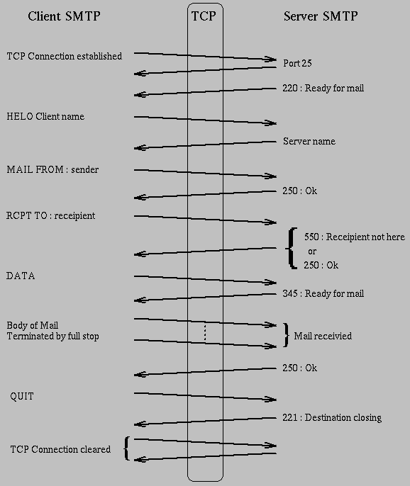

Slide 21
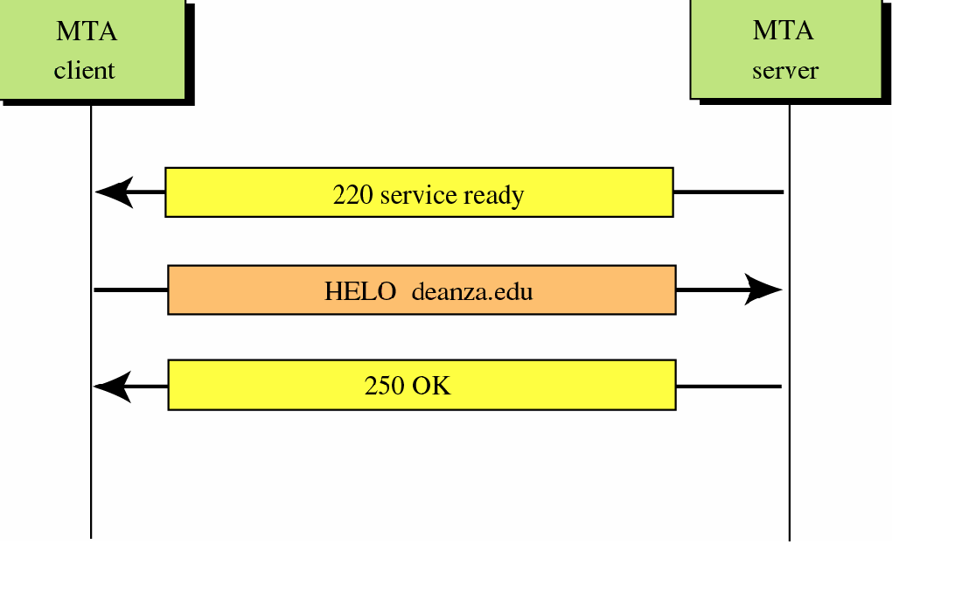
Connection Establishment
SYN
Ephemeral port
SYN+ACK
Ephemeral port
Port 25
SYN
Port 25
Notes:
The session starts with the client establishing a TCP connection with the server well known port, 25. Once this is done, the server responds with a PDU 220 (ready for mail). The client and server then exchange names with a HELO Client name from the client and a corresponding Server’sresponse.

Slide 22
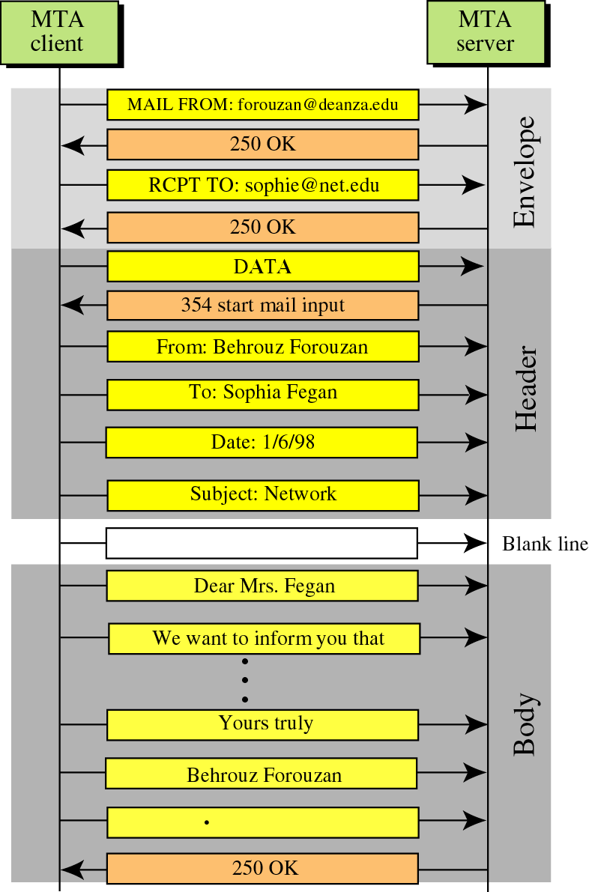
Ephemeral port
Port 25
Notes:
The mail message starts with a MAIL FROM: message from the client. After a 250 (Ok) response from the server the client then sends a RCPT TO: indicating the name of the intended recipient of the email. The server then has two options: It can either send 250 indicating that the recipient exists on its system or it can send 550 (recipient not here) which will result in the message not being sent by the client.
Once the Ok message has been received by the client it sends DATA which is actually the header of the mail message. Following this the server sends a 345 (Ready for mail) indicating that it is now ready for the body of the mail. The client then sends the body which is terminated by a line containing a single full stop. The end of the mail is acknowledged by the server with another 250 message.

Slide 23
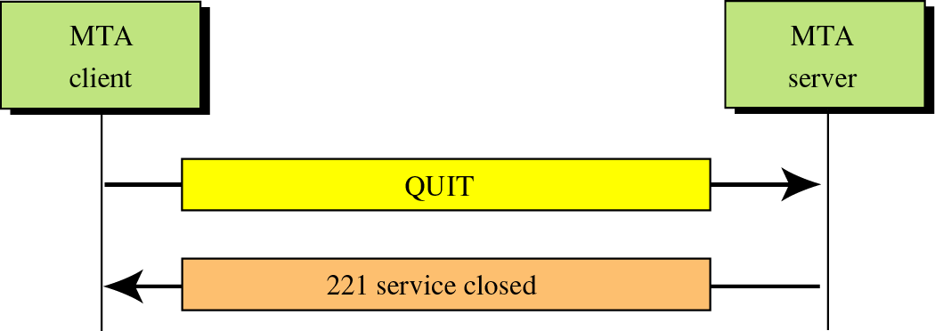
Connection Termination
Ephemeral port
Port 25
FIN
ACK
RESET
Notes:
Finally the connection is broken gracefully. The client sends a QUIT which is answered by the server using a 221(Destination closing) message. The connection is then terminated using the normal TCP termination method.

Slide 24
Limitations in SMTP
Only uses NVT 7 bit ASCII format
  How to represent other data types?
Susceptible to misuse (Spamming,
faking sender address)

Slide 25
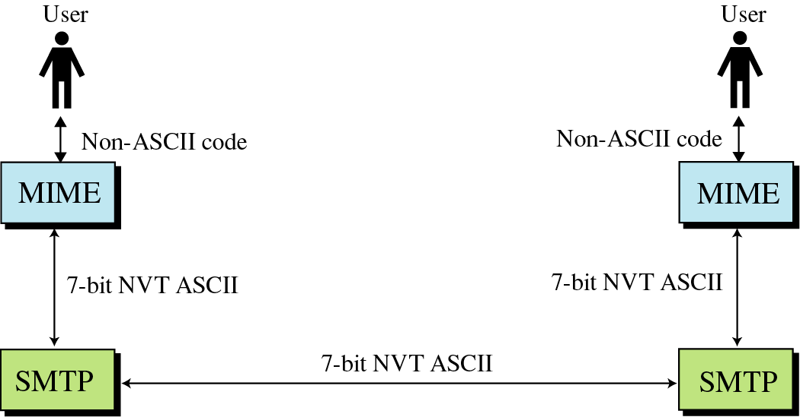
Solution: SMTP extensions
MIME – Multipurpose Internet Mail Extensions
  Transforms non-ASCII data to NVT (Network Virtual Terminal) ASCII data

Slide 26
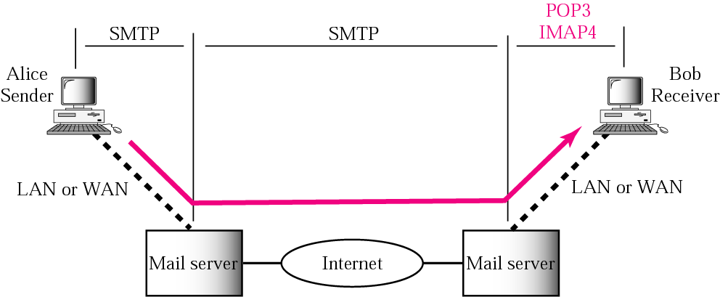
Mail Access Protocols: POP3 & IMAP4
POP3
IMAP4
SMTP
SMTP

Slide 27
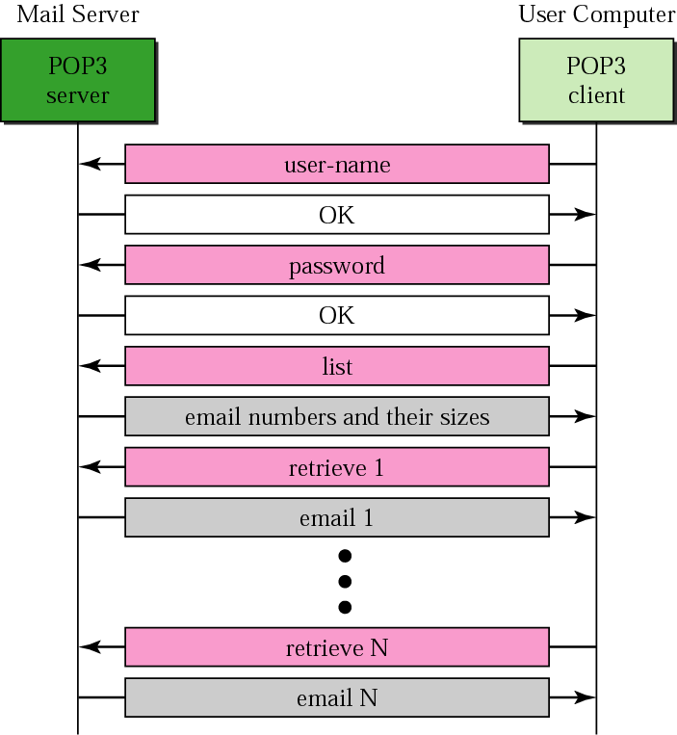
POP3

Slide 28
Post Office Protocol v3
Allows the user to obtain a list of their Emails
Users can retrieve their emails
Users can either delete or keep the email on their system
Minimizes server resources

Slide 29
Internet Mail Access Protocol Ver4
User can check the email header before downloading
Can search the email for a specific string of characters before downloading
User can download parts of an email
User can create, delete, or rename mailboxes on a server

